Slide 1
Building a Strong Talent Acquisition Strategy in Alaska
Mary M. Rydesky transition Management consulting September 2018
SHRM

Slide 2
Objectives
1. Define talent acquisition management & its metrics for organization leaders
2. Understand how to build & execute an employer brand strategy
3. Create an improved candidate experience

Slide 3
Building a Strong Talent Acquisition Strategy in Alaska
Recruiting & hiring are changing

Slide 4
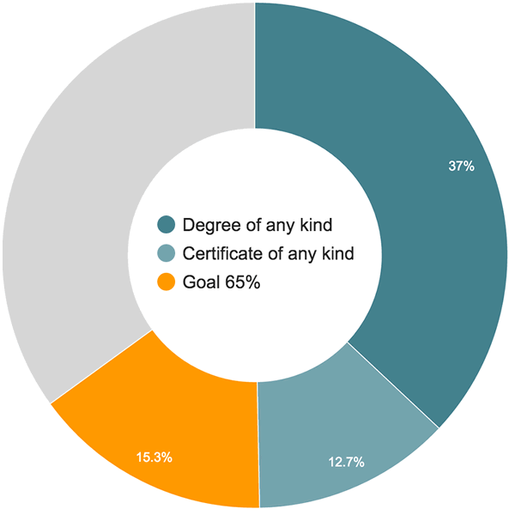
Alaska’s Jobs & Workforce Require alignment
“need to increase the percentage of working-age Alaskans who hold postsecondary credentials – from apprenticeship or certificate completion to advanced degrees – to 65% by the year 2025”
- -Alaska Can http://65by2025.org/
Notes:
Group’s vision is for Alaska’s economy to be driven by Alaskans with relevant credentials to attain individual & collective economic independence
4th annual conference was March 2018
explain what “Alaska Can” is, & why this goal is so important, & necessary from early childhood education to post secondary ed – can we grow our own to strengthen our economy? Yes!

Slide 5
Workforce: A Desire for reassurance
43% of millennials envision leaving their jobs within two years
61% of Gen Z say the same thing
increased confidence in the currently strong job market
their company’s priorities don’t align with their own
--Deloitte, 2018

Slide 6
recruiting technology leaders have shifted the way modern companies hire
--J T O’Donnell, 2018
Does the technology add to your recruiting process?

Slide 7
90% of job-seekers use mobile devices to search for a job
--Charney, 2016
Charney, D. (2016). 7 hiring strategies to overcome the talent crunch. Material Handling & Logistics, 71(4), 29–31. Retrieved from https://ezp.waldenulibrary.org/login?url=https://search.ebscohost.com/login.aspx?direct=true&db=iih&AN=114798869&site=eds-live&scope=site
Notes:
How does your career & jobs page look on small screens? Have you applied for a job at your company using a mobile phone? TEST IT!

Slide 8
Efficiency through technology
“Many job seekers have long suspected their online employment applications disappear into a black hole, never to be seen again. Their fears may not be far off the mark, as more companies rely on technology to winnow out less-qualified candidates.”
- Wall Street Journal, 2012

Slide 9
What is Strategic Talent Acquisition Management?
(Is this just another way of saying recruitment?)
Notes:
Objective One

Slide 10
Strategic talent acquisition management…
Niche markets: specific skills needed
Competitive industries: skills & dollars ‘talk’
Fast-growth companies: need strategy to reduce time-to-fill
Executive leadership roles: succession planning
Alaska: limited workforce, required growth
Notes:
Consider your company, your industry, your required skill sets. Can you fill the needs by hiring soley in Alaska? For how far in the future?

Slide 11
Strategic talent acquisition management…
Create a talent pool (Alaska Can!)
Project company needs 5 – 7 years out
Keep & study the right metrics
Balance mission & metrics
Promote brand
Hire differently
Notes:
HR strategic priorities – ask audience to rank order importance in their organizations

Slide 12
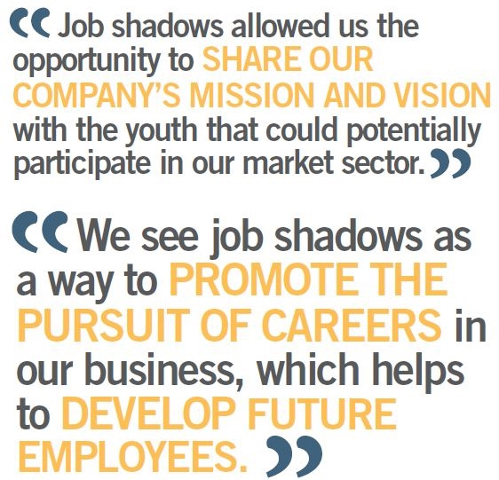
Create a talent pool
Job shadowing through school partnerships
Externships
Apprenticeships
Career ladders
Notes:
Externships are experiential learning opportunities, similar to internships but generally shorter, provided by partnerships with educational institutions & employers to give students short practical experiences in their field of study.
An apprenticeship (almost) guarantees you a high paying job once you successfully complete the skills learning portion

Slide 13
HR DEPT. Internship – Tao Mgt
Our training program is accredited at many Universities, 3-6 months in length, & unpaid. During this program, you will learn how to CrowdSource employees & work in an Agile environment using Office 365 & our own software known as FocusPass. We specialize in having employees contribute in wiki-style using resources such as Sharepoint, Microsoft Teams, & GitHub. This means we have no huge office. We have a lot of remote employees all over the world & then also own a few live/work houses where we dance, play, eat healthy, do yoga, & do work together. You can work with us 100% online or you may choose to stay in our live/work houses for a room & boarding fee. Your HR Experience will involve interviewing, motivating, & even help automating our HR process. You can also get involved on our Artificial Intelligence HR software, our FocusPass employee training software, or other aspects such as compliance, I-9 verification, & HR workflows. We spend quality time with students that are open minded, well rounded people, who find solutions, & are able to manage their tasks online. We have over a million clients nationwide & are experts in web design, iphone app development, book & magazine publication, dancing, physical fitness, fashion design, & creative branding, to name a few. You will find creative ways to fill these roles, retain existing members, & provide tools & services to our staff or members. Each HR intern has a unique career path & we desire you to find your own passion within our organization.
Notes:
Would you like to take up this offer?
Marietta OH
“We streamline and let business flow naturally. We manage with community at the center of our vision.”
www.taomgt.com

Slide 14
Project future company needs 5 – 7 years out
Are you at the C-suite table?
Connect strategic plans to the HR plan
Gain support for long-term
(rather than on-demand hiring)
Notes:
Start with the business objective – a company that will survive is one that has a different objective from today’s. The objective is market driven!
MBASkool.com image

Slide 15
The right metrics
Notes:
What do you measure? These were big in 2010 and here is the direction for 2020. These include effectiveness measures – how many f your new hires stay? How long? How many are promoted within 6 months, 1 year, 3 years? How many of your current hires recruit for you?

Slide 16
Dashboards
Measure the right thing
Measure it in real time
Make it visual
Notes:
Why is this important? Lead to next slide

Slide 17
When companies select the top 20% of candidates based on a scientific assessment, they realize 41% less absenteeism, 70% fewer safety incidents, 59% less turnover, 10% higher customer metrics, 17% higher productivity & 21% higher profitability…
--Gallup, 2016
Hickman, A., & Campbell, K. (2016). Manager Bias in Hiring: The Fix. Gallup Business Journal, 1–1.

Slide 18
What About the company experience?
Time to Hire
Retention of Talent
Time to Promotion
Notes:
Do you know your high low and average days for each step?
TargetRecruit.blog

Slide 19
What About the candidate experience?
Poor communication
Automated communication
Slow
Bad process
Awkward technology
Insufficient job details
Notes:
Do you know your high low and average days for each step?
Blog.greathires.co March 13 2017
Research shows the most common sources of negative candidates experiences are the following:
Job details don’t tell the candidate enough information
Application process is too long or complicated
“Did you get my application?”
Poor interaction(s) between candidate and the hiring team
Speed of decision making
“Where do I stand?
Site is not mobile friendly

Slide 20
Metrics for the candidate experience
Start to end time
Time per step
Communications per step
Pre-employment acculturation events
Notes:
Metrics that matter – what did the candidate experience?

Slide 21
Show Balance OF mission (and values) with metrics
The best talent has multiple opportunities (do not delay!)
Offer a career growth opportunity (not just KSA lists)
KPO-based interviewing finds ‘fit’ with mission
Hire for potential over skills
Convert applicants into acquaintances before making offers
--Lou Adler, 2018 Sep 4
Notes:
Take these to heart…..

Slide 22
Mission & Margin
Balance of purpose (heart) & metrics (measures of profitability)
Notes:
New goal for the HR Strategist
Image https://www.pinterest.com/pin/52846995607906323/

Slide 23
Value congruence
Alignment between the value hierarchy of individuals & the organization
Stronger culture
CSR commitment
Better leadership decisions (values driven)
Better talent acquisition, lower attrition
Greater job satisfaction (P-E Fit)
Notes:
Revise job descriptions and ads to align with value congruence to have growth of positive corporate culture

Slide 24
Promote brand
How is your organization ‘known’?
How does your organization want to be known?

Slide 25
Brand is sellable
“Best Workplace In…”
Safe place to work
Just & fair
Supports community
Leaders are trusted

Slide 26
Brand is sellable
“Best Workplace In…”
Safe place to work
Just & fair
Supports community
Leaders are trusted

Slide 27
Is your company showing up?
Notes:
http://www.akbizmag.com/Welcome-to-the-2018-Best-of-Alaska-Business-Awards/

Slide 28
Media Check
Glassdoor.com Zippia.com LinkedIn.com Niche.com
Alaska Business Monthly
Anchorage Press
Notes:
www.searchcontents.com

Slide 29
Brand
CSR affects
Community
Candidates
Employees
Contractors
Notes:
Your company’s commitment to social change

Slide 30
Hire differently: 15 ideas
Brand your organization
“Best Workplace”
Safe place to work
Just & fair, not just legal
CSR orientation

Slide 31
Hire differently: 15 ideas
Post jobs strategically
Monitor the media
Incentivize for referrals
Stay legal (salary inquiries)
65 by 2025-grow your own

Slide 32
Hire differently: 15 ideas
Personalize the values
Hire for culture (P-E Fit)
Topgrading
Change the interview schedule
Change the questions
Notes:
Schedule or schedule?

Slide 33
The Interview Schedule
Video interview
Group interview
Personal interview
Interview BY candidate
Relationship building
Notes:
Uniformity, & changed design again.

Slide 34
The Interview Questions
Coach the first question
Ending question
Personal interview
Interview BY candidate
Value Congruence

Slide 35
Metrics… But What is the Candidate Experience?
Pre-candidate Experience
Application Completion
Candidate Readiness
Recruiter Response Times
Offer Acceptance Rates
Notes:
Look closely at your automation – is is pushing out the human element? That is costly and detrimental to the health of your corporate culture.
AND to you CSR!

Slide 36
What Will you do now for
Talent acquisition management & metrics
Brand strategy development & use
Improved candidate experience
Notes:
Start your list of strategic planning priorities. Base line measure and plan for quarterly comparisons. Use new Excel for dashboard development.

Slide 37
Comments & Questions

Slide 38
Future opportunities
Please visit www.transitionmanagement.us
brochure & registration online

Slide 39
Mary M. Rydesky
As a professional manager of training & an educator, Mary Rydesky combines practical experience with MBA theory. Her background in HR, IT services, & administration of learning management has centered on one theme: HR functions & especially training must have a measurable impact on behavior to be worth the time & cost. She serves on the board of the AK Statewide Trainers & Developers & is a member of the Association for Training & Development & National Career Development Association. She heads Transition Management. She holds a BA in Communications, Arts, & Education, a Masters in Library & Information Science, & an MBA. She is researching trust in the workplace for her doctoral research in HR Management. mrydesky@transitionmanagement.us

